Slide 1
INTRODUCTION TO INFORMATION RETRIEVAL CSE535 TEAM YAGOO
MAGIZH
DINESH
MANOJ

Slide 2
TOPICS
Analysis of the Corpus
Phase Two
Phase Three
Static Score Computation
Faceted Search
Conclusion

Slide 3
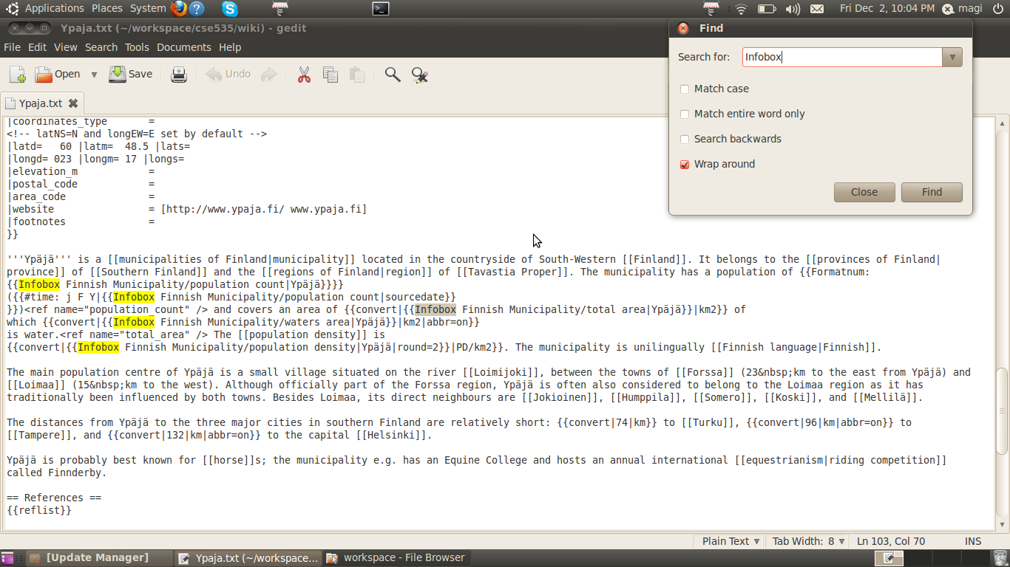
ANALYSIS OF THE CORPUS
Parsing – Identifying Structural Deviations
Link Filtering

Slide 4
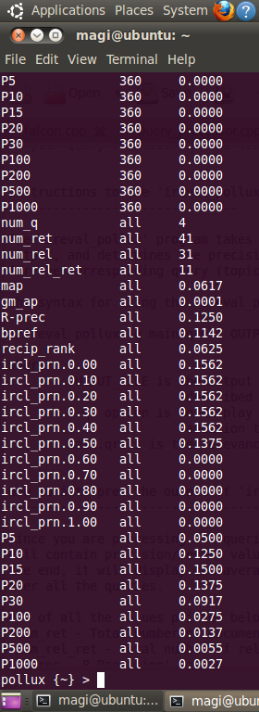

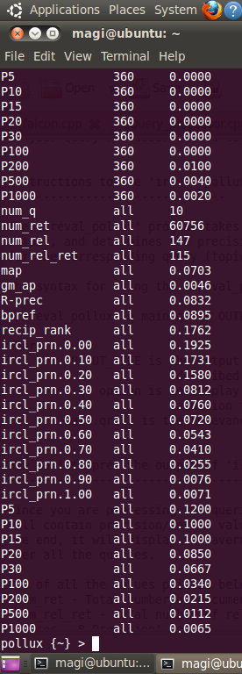
PHASE TWO – OFFLINE MODE
BOOLEAN
COSINE
OKAPI

Slide 5
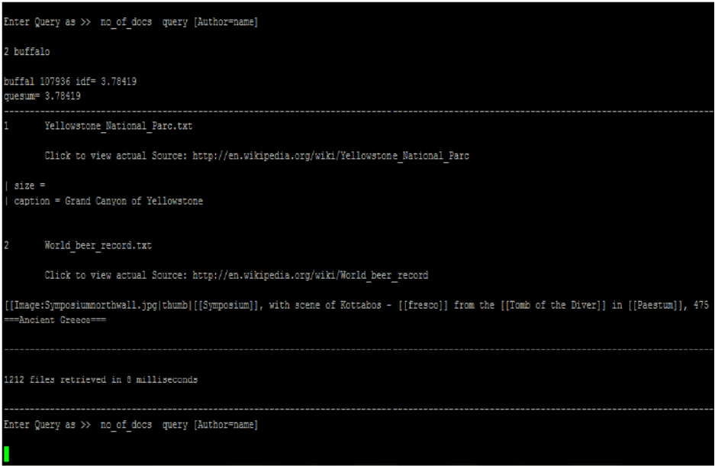
PHASE TWO – ONLINE MODE

Slide 6
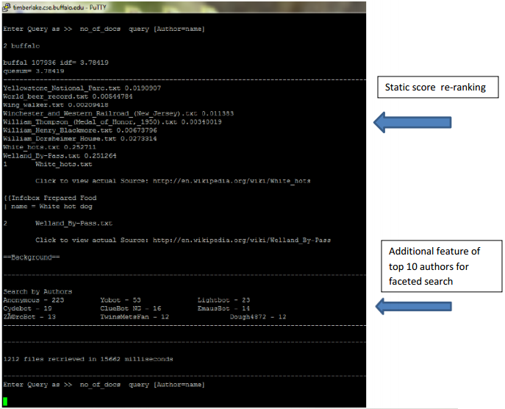
PHASE THREE

Slide 7
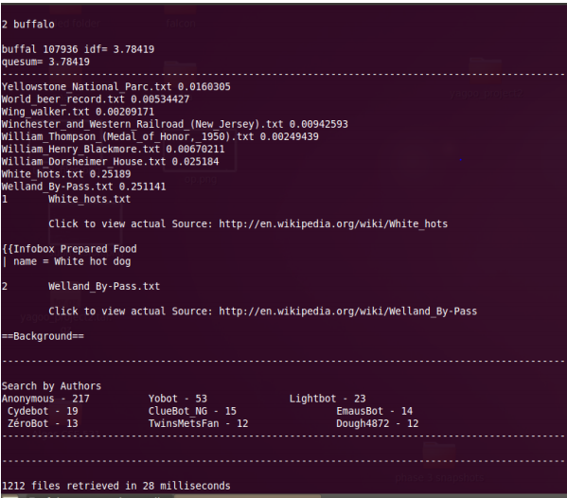
IN-MEMORY INDEXING
RETRIEVAL
TIME

Slide 8
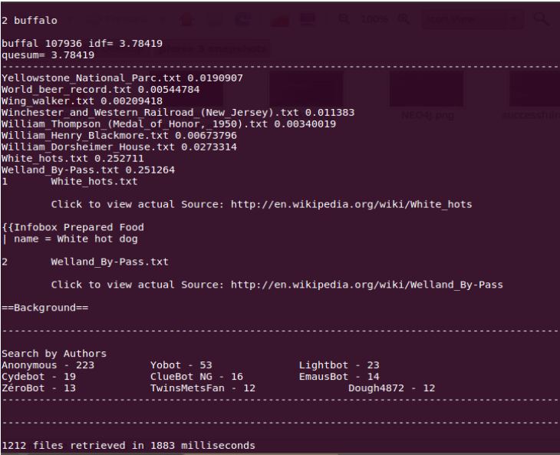
WITHOUT IN-MEMORY INDEXING
MORE RETRIEVAL
TIME

Slide 9
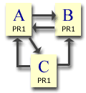

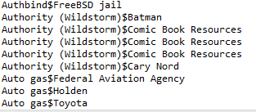
STATIC SCORES
Page Rank
Links to Same Page
Link to Other Pages
http://www.webworkshop.net/pagerank.html

Slide 10
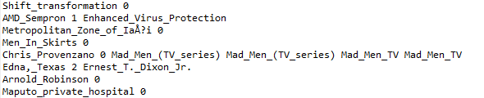
http://www.webworkshop.net/pagerank.html
A 5 B C
In-Links
Number of Out-Links

Slide 11

Authority Score
Computed based on the number of references to the author
Quality Score
Number of sections and references
Specificity Score
Relevance of the document to the Category mentioned.
Calculated by the Jaccard coefficient between Category and the
Content

Slide 12
CONCLUSION
Trade off between Memory, Retrieval time and Accuracy
For a Static collection design is Corpus based.
Information Retrieval is beyond mere Retrieval

